Slide 1
Gradient Boosting
A Brief Introduction and Explanation
Wang Xinyu 1098648
Notes:
Hello, today I will introduce Gradient Boosting method

Slide 2
Introduction
Gradient Boosting
Just like AdaBoost, Gradient Boosting works by sequentially adding predictors to an ensemble, each one correcting its predecessor.
However, instead of tweaking the instance weights at every iteration like AdaBoost does, Gradient Boosting, which borrows its ideas from the gradient descent method, tries to fit the new predictor to the residual errors made by the previous predictor.
Notes:
Just like AdaBoost, Gradient Boosting works by sequentially adding predictors to an ensemble, each one correcting its predecessor.
However, instead of tweaking the instance weights at every iteration like AdaBoost does, Gradient Boosting, which borrows its ideas from the gradient descent method, tries to fit the new predictor to the residual errors made by the previous predictor.

Slide 3
Gradient Descent
Notes:
Before introducing the gradient boosting, I will introduce or review the gradient descent at first since those two methods share similar ideas.

Slide 4
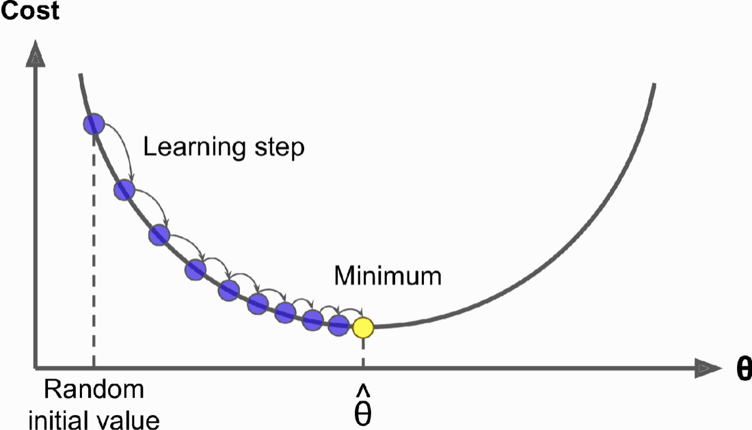
Gradient Descent
Brief Introduction or Review?
Gradient Descent is a first-order iterative optimization algorithm for finding a local minimum of a differentiable function. The general idea of it is to tweak parameters iteratively in order to minimize a cost function.
The model parameters are initialized randomly and get tweaked repeatedly to minimize the cost function; the learning step size is proportional to the slope of the cost function, so the steps gradually get smaller as the parameters approach the minimum
Notes:
Gradient Descent is an iterative algorithm for finding a local minimum of a differentiable function. The general idea of it is to tweak parameters iteratively in order to minimize a cost function.
You can see that, on the graph, we start by filling theta with random values. Then we improve it gradually, taking one baby step at a time, attempting to decrease the cost function, util the algorithm converges to a minimum.

Slide 5
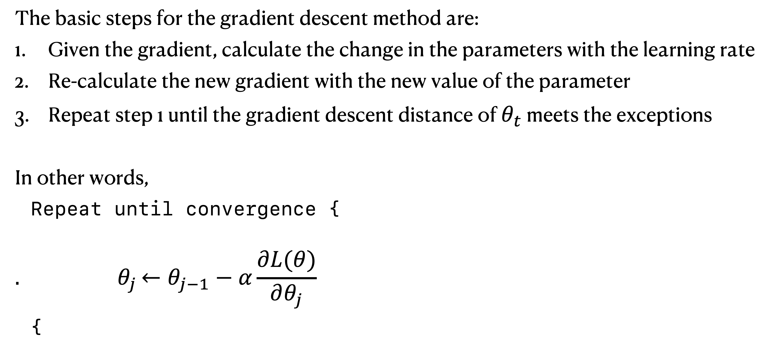
Gradient Descent
Basic Steps
The basic steps for the gradient descent method are:
Given the gradient, calculate the change in the parameters with the learning rate
Re-calculate the new gradient with the new value of the parameter
Repeat step 1 until the gradient descent distance of $θ_{t}$ meets the exceptions
In other words,
Repeat until convergence {
$${. θ}_{j}←θ_{j−1}−α\frac{∂L(θ)}{∂θ_{j}}$$
}
Notes:
And here is the basic steps for the gradient descent method, in short, gradient descent method is to repeat the iterative function theta until convergence.

Slide 6
Gradient Boosting
Notes:
Next, let’s back to Gradient Boosting.

Slide 7
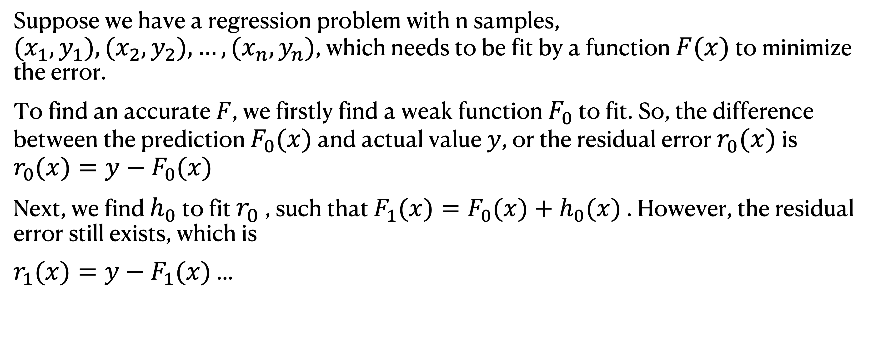
Gradient Boosting
Brief Introduction
Suppose we have a regression problem with n samples, $(x_{1},y_{1}),(x_{2},y_{2}),…,(x_{n},y_{n})$, which needs to be fit by a function $F(x)$ to minimize the error.
To find an accurate $F$, we firstly find a weak function $F_{0}$ to fit. So, the difference between the prediction $F_{0}(x)$ and actual value $y$, or the residual error $r_{0}(x)$ is
$$r_{0}(x)=y−F_{0}(x)$$
Next, we find $h_{0}$ to fit $r_{0}$ , such that $F_{1}(x)=F_{0}(x)+h_{0}(x)$ . However, the residual error still exists, which is
$r_{1}(x)=y−F_{1}(x)$ ...
Notes:
Here is an example of applying Gradient Boosting to a regression problem with n samples.
To find an accurate F, we firstly find a weak function F0 to fit. So, the difference between the prediction and the actual value is y - F0(x). Next, we find h0 to fit r0, such that F1(x) = F0(x) + h0(x), and the residual error still exists, which is r1(x) = y - F1(x).
Gradient Boosting would keep these steps over and over again util it met the predefined error boundary.

Slide 8
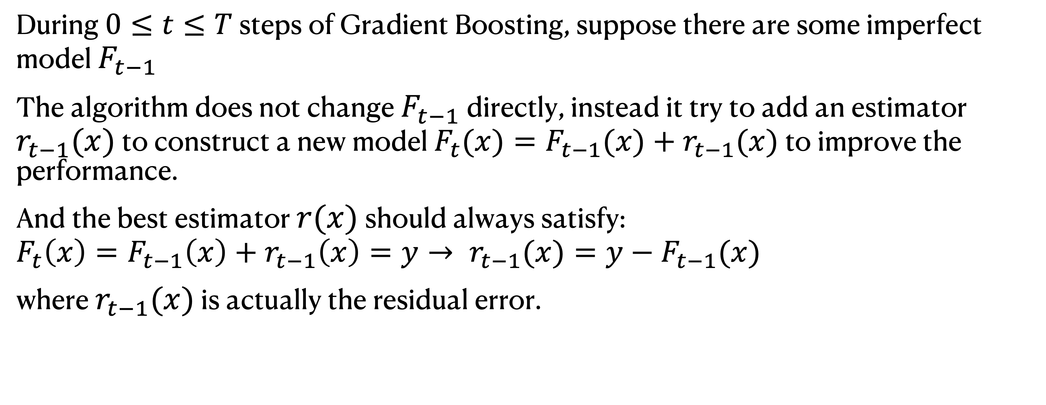
Gradient Boosting
Brief Introduction
During $0≤t≤T$ steps of Gradient Boosting, suppose there are some imperfect model $F_{t−1}$
The algorithm does not change $F_{t−1}$ directly, instead it try to add an estimator $r_{t−1}(x)$ to construct a new model $F_{t}(x)=F_{t−1}(x)+r_{t−1}(x)$ to improve the performance.
And the best estimator $r(x)$ should always satisfy:
$$F_{t}\left(x\right)=F_{t−1}\left(x\right)+r_{t−1}\left(x\right)=y→ r_{t−1}(x)=y−F_{t−1}(x)$$
where $r_{t−1}(x)$ is actually the residual error.
Notes:
So, for general problems. During 0 to T steps of Gradient Boosting, suppose there are some imperfect model F_{t-1}.
The algorithm does not change the model directly, instead it try to add an estimator to construct a new model to improve the performance.

Slide 9
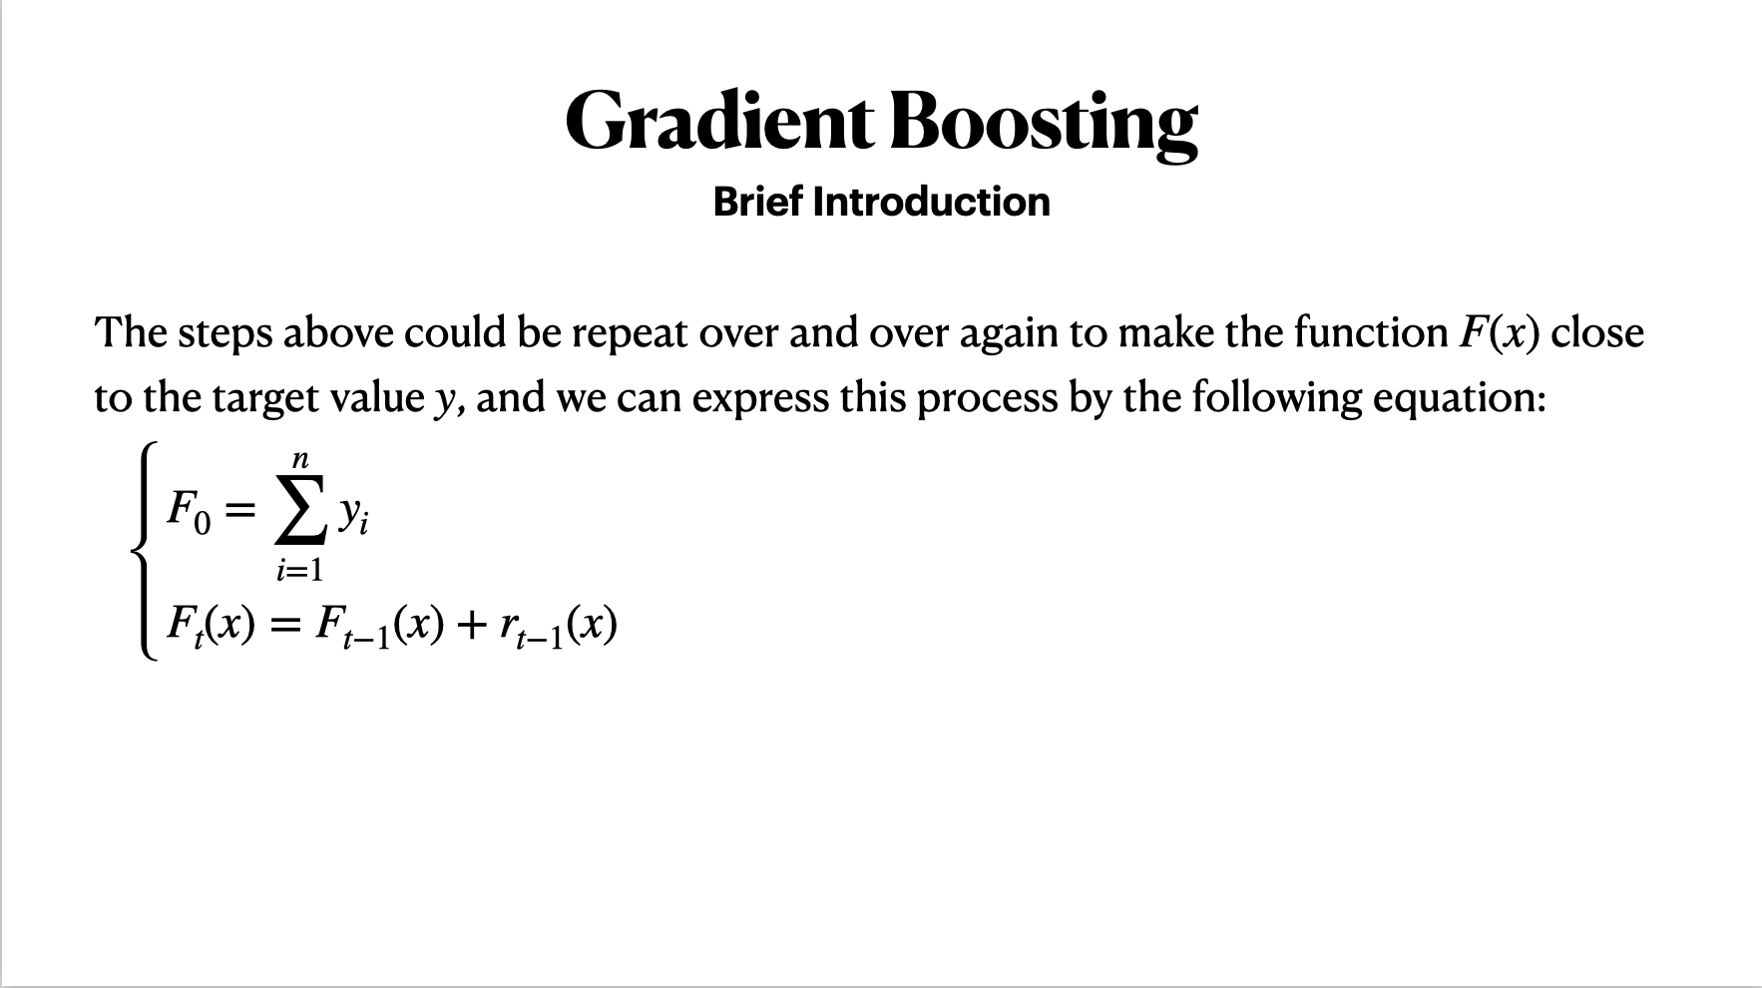

Slide 10
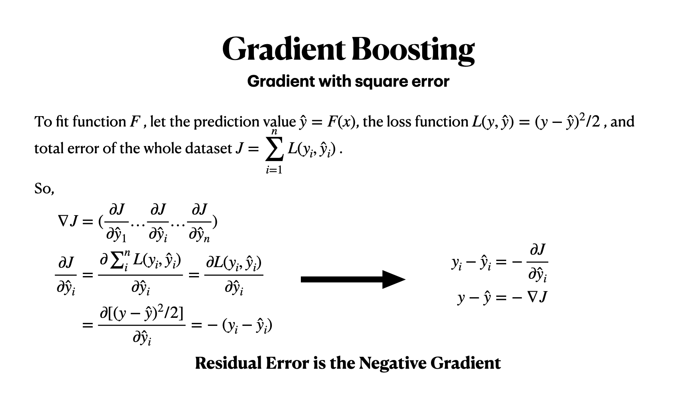

Slide 11

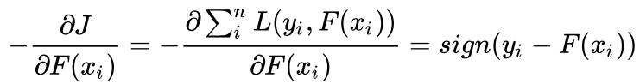
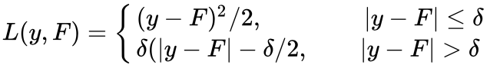
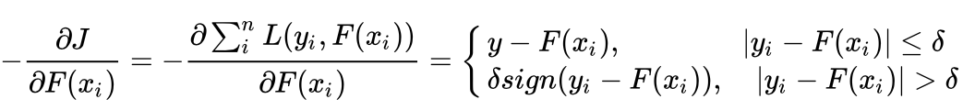
Gradient Boosting
Gradient with other error
1. Absolute Error:
Negative Gradient:
2. Huber Error
Negative Gradient:
Notes:
We can see that for absolute error and Huber error, negative gradient does not equal to residual error, but the negative gradient error is also calculated according the loss function L. And the result of the negative gradient has some relationships between the residual error -- They are variants of the residuals error or they are residual error with some adjustment.
Besides, compare to the original residual error y - F(x), the negative gradient of absolute error and Huber error weaken the influence of outliers, or they are less sensitive to errors

Slide 12
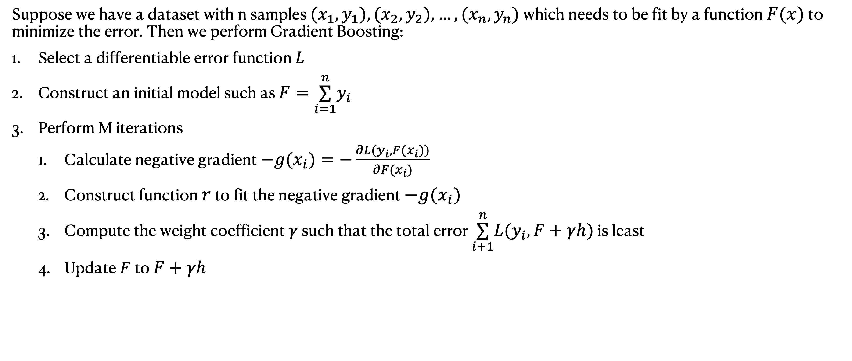
Gradient Boosting
Steps of Gradient Boosting & Summary
Suppose we have a dataset with n samples $(x_{1},y_{1}),(x_{2},y_{2}),…,(x_{n},y_{n})$ which needs to be fit by a function $F(x)$ to minimize the error. Then we perform Gradient Boosting:
Select a differentiable error function $L$
Construct an initial model such as $F=\overset{n}{\underset{i=1}{∑}}y_{i}$
Perform M iterations
Calculate negative gradient $−g(x_{i})=−\frac{∂L(y_{i},F(x_{i}))}{∂F(x_{i})}$
Construct function $r$ to fit the negative gradient $−g(x_{i})$
Compute the weight coefficient $γ$ such that the total error $\overset{n}{\underset{i+1}{∑}}L(y_{i},F+γh)$ is least
Update $F$ to $F+γh$
Notes:
So, here is the steps of applying gradient boosting. First we select a differentiable error function and then construct an initial model, and finally perform iterations until it meet the requirement.
Like other Boosting methods, Gradient Boosting is also an iterative process of building weak models that are progressively enhanced (Boosting) and combined into strong models. However, while other Boosting methods such as AdaBoost iteratively adjust the weights of the samples, Gradient Boosting iteratively fits negative gradients and adjust the weight coefficient of the negative gradient.

Slide 13
Thank You

Slide 14
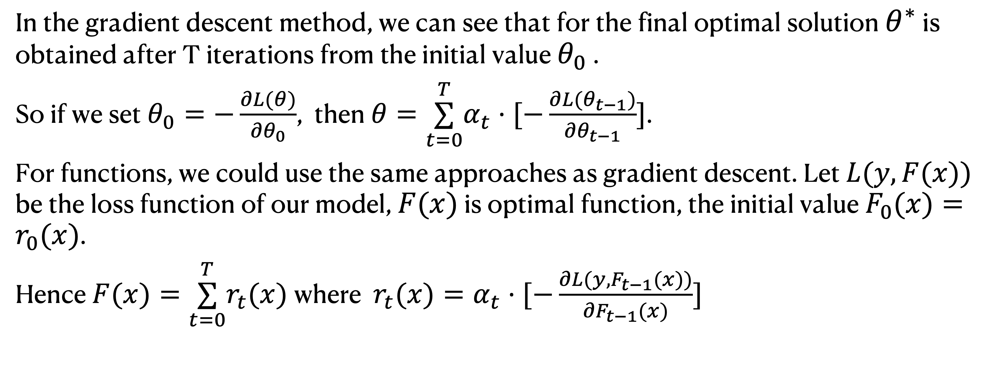
Gradient Boosting
In the gradient descent method, we can see that for the final optimal solution $θ^{∗}$ is obtained after T iterations from the initial value $θ_{0}$ .
So if we set $θ_{0}=−\frac{∂L(θ)}{∂θ_{0}}$, then $θ=\overset{T}{\underset{t=0}{∑}}α_{t}⋅[−\frac{∂L(θ_{t−1})}{∂θ_{t−1}}]$.
For functions, we could use the same approaches as gradient descent. Let $L(y,F(x))$ be the loss function of our model, $F(x)$ is optimal function, the initial value $F_{0}(x)=r_{0}(x)$.
Hence $F(x)=\overset{T}{\underset{t=0}{∑}}r_{t}(x)$ where $r_{t}(x)=α_{t}⋅[−\frac{∂L(y,F_{t−1}(x))}{∂F_{t−1}(x)}]$

